Slide 1
Dr Anita Sharma
GPwSI Gynaecology
Chair and Founder of Endometriosis Awareness North
Chair of Women's Doctors Forum BIDA
Education Lead FDA North-West
Undergraduate Trainer University of Manchester
GP Member NICE QS Endometriosis, menopause, Breast CA
Ex Clinical Director Vascular and MO Oldham CCG

Slide 2
MISSION STATEMENT
ENDOMETRIOSIS AWARENESS NORTH CHARITY
AWARENESS,
EDUCATION,
EARLY INTERVENTION AND RESEARCH.
GET INVOLVED, SHARE YOUR STORY

Slide 3

Women’s Health Strategy for England Published December 2021
PROMOTE GOOD HEALTH
PREVENT NEGATIVE HEALTH OUTCOME
RESTORE HEALTH &WELL BEING

Slide 4
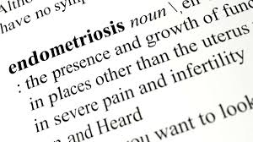
ENDOMETRIOSIS:
Is a condition characterized by the presence
of
TISSUE RESEMBLING ENDOMETRIUM
OUTSIDE OF THE UTERUS
WHAT
IS
ENDOMETRIOSIS

Slide 5
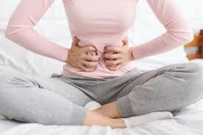
DIAGNOSIS
Suspected Endometriosis in Women
(including young women aged 17 and under)
presenting with 1 or more of the following symptoms and signs:
Chronic pelvic pain
Dysmenorrhoea
Deep pain during or after Sex
GI symptoms
Urinary symptoms
Infertility

Slide 6
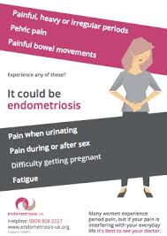

Slide 7

ENDOMETRIOSIS or MENSTRUAL CRAMP

Slide 8

Persisting pain during period
Severe enough to interfere with normal activities
Lasting longer than 2-3 days

Slide 9
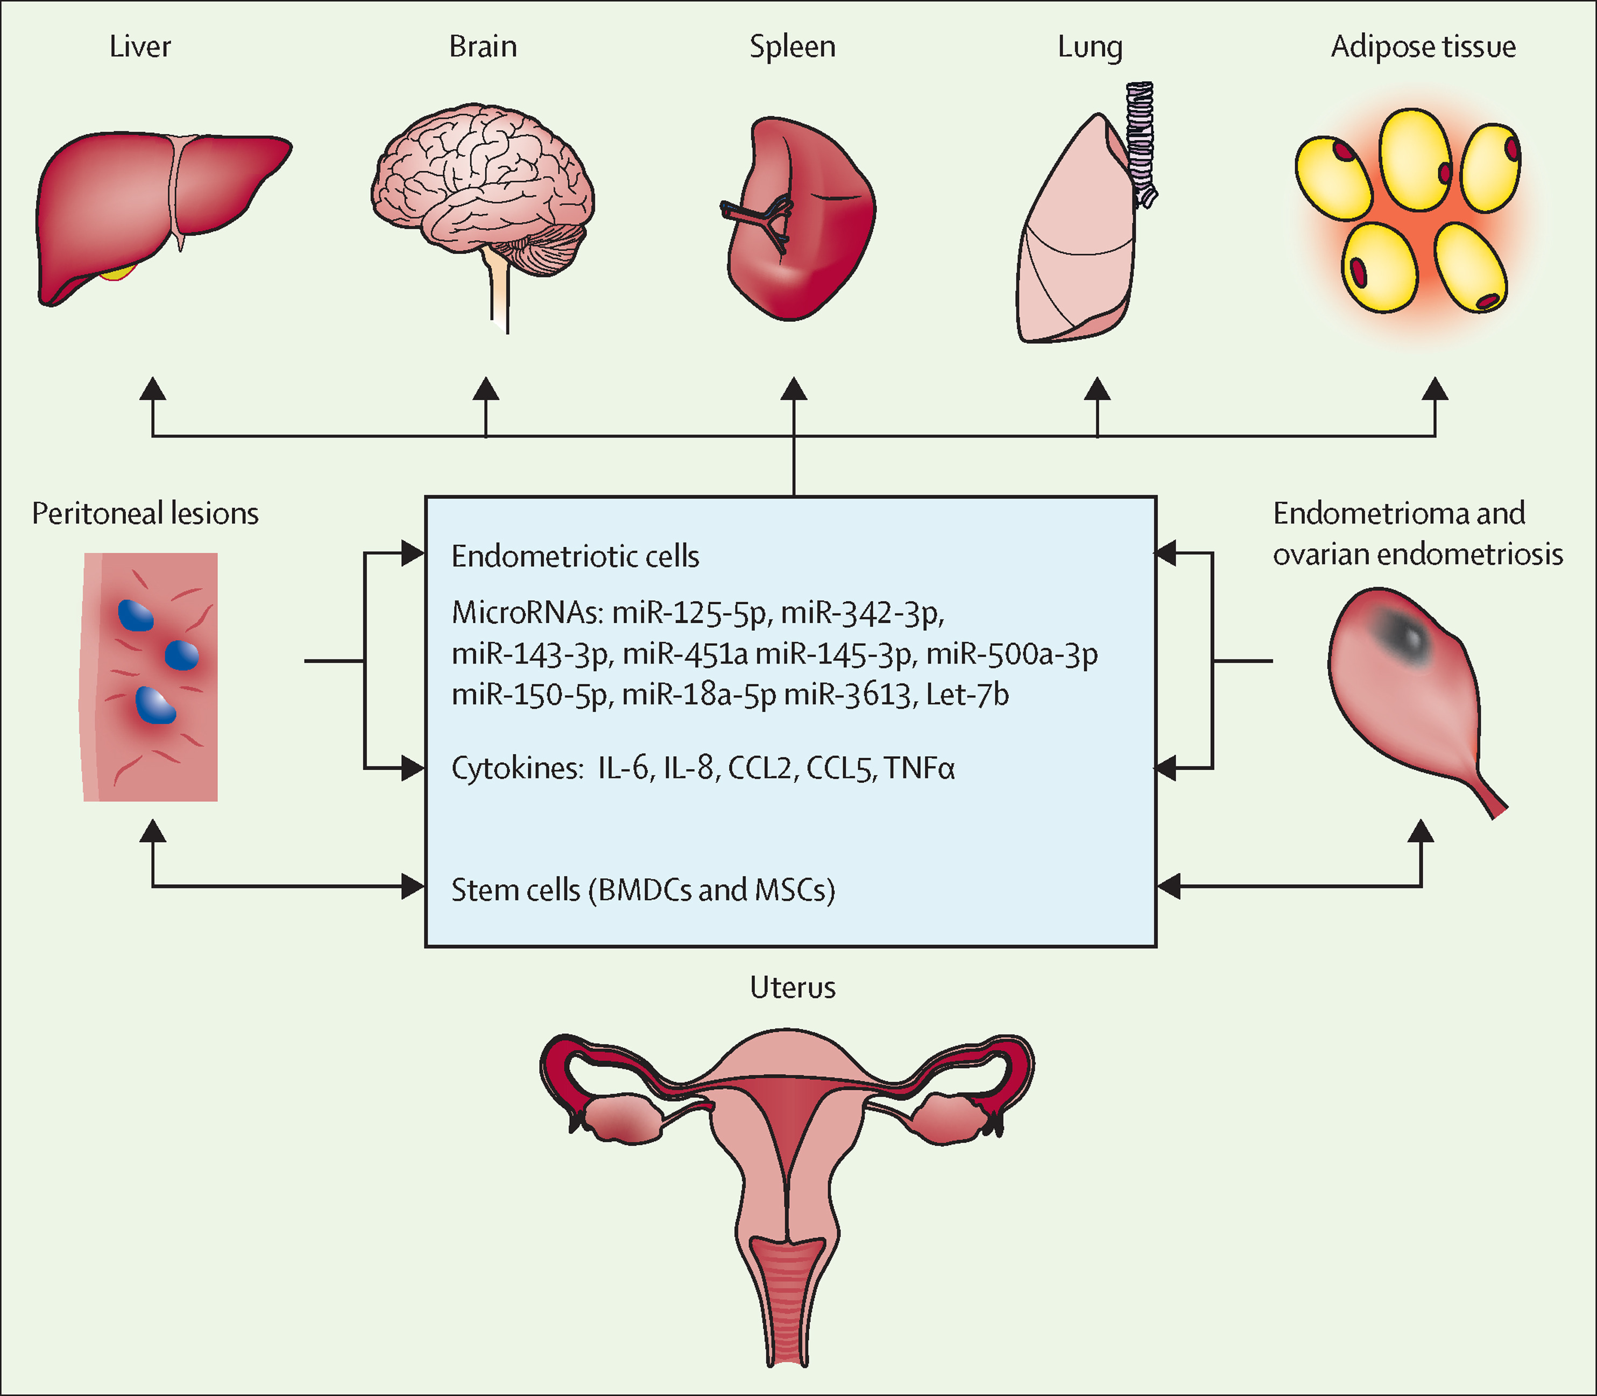
SPREAD

Slide 10
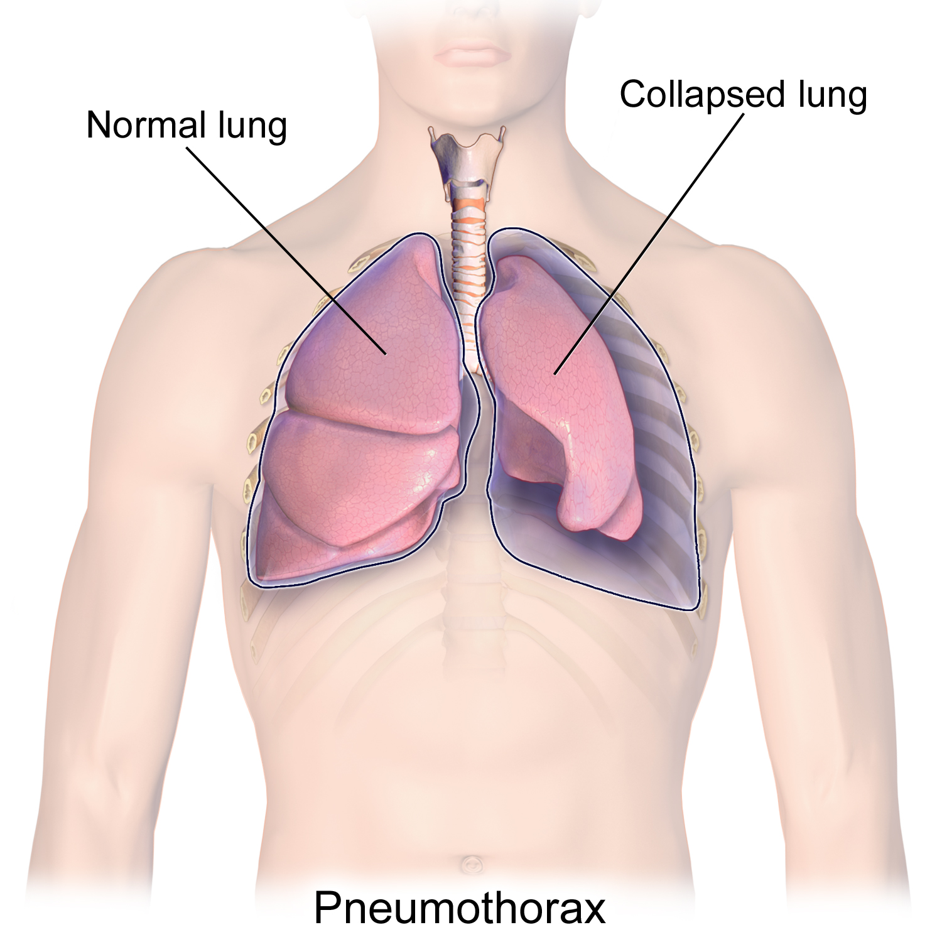
ENDOMETRIOSIS LUNG 26-year-old Coughing Up Blood

Slide 11


FACTS
Endometriosis is estimated to affect
1.5 MILLION WOMEN in the UK
Globally , it affects 190 MILLION WOMEN
It takes on average 7.5 YEARS to make a diagnosis
27 is the average age when a woman is first diagnosed with endometriosis

Slide 12
FACTS
Difficulty Conceiving can occur In 30 - 50 % of Cases
It can have a significant Impact on the:
Diagnosis for Endometriosis is Appallingly Slow
Research
Mental Health Support For Victims
PHYSICAL,
MENTAL,
PSYCHOLOGICAL
SOCIAL

Slide 13
Why Is The CARE POOR IN The UK
The Stigma associated with discussing period problems and painful sex
Lack of awareness of symptoms and not seeking early help from GP
Lack of Specialist Support
GP’s Lack of Awareness and Training
Poor Training

Slide 14


Slide 15

NCEPOD REPORT 11.7.2024
LACK OF ENDOMETRIOSIS PATHWAY
AND
POOR SYMPTOM RECOGNITION
HINDER CARE
Many Drs including Gynaecologists still believe a painful period is normal

Slide 16
Role of Primary care
SEE YOUR GP

Slide 17
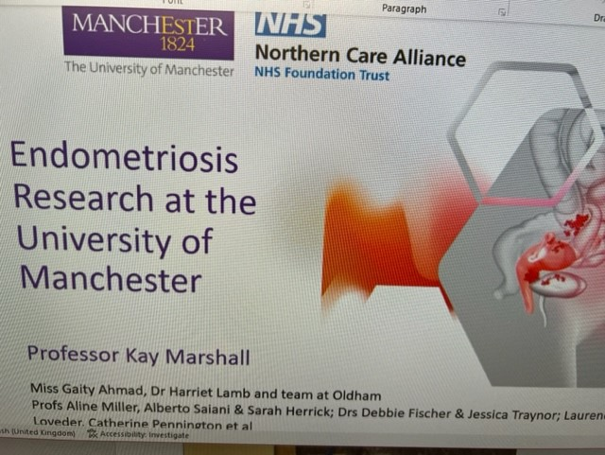
ENDOMETRIOSIS RESEARCH AT UNIVERSITY OF MANCHESTER IRAS 294763
Professor Kay Marshall
Miss Gaity Ahmad
Harriet Lamb
Prof. A Miller
Alberto Salari
Sarah Herrick
Dr D Fletcher
Dr Jessica Traynor

Slide 18



Slide 19
THANK YOU
Thank you for attending this Endometriosis Awareness Session
If you require any further information our Contact Details
email address:- endometriosisawarenessnorth@gmail.com
Twitter/ X :- @DrAnitaEndo
Web:- www.endometriosisawarenessnorth.com
Facebook:- Endometriosis Awareness North

Slide 20



BOOKS BY Dr.ANITA SHARMA

Slide 21

FIRST BMA PRIZE 1995

Slide 22
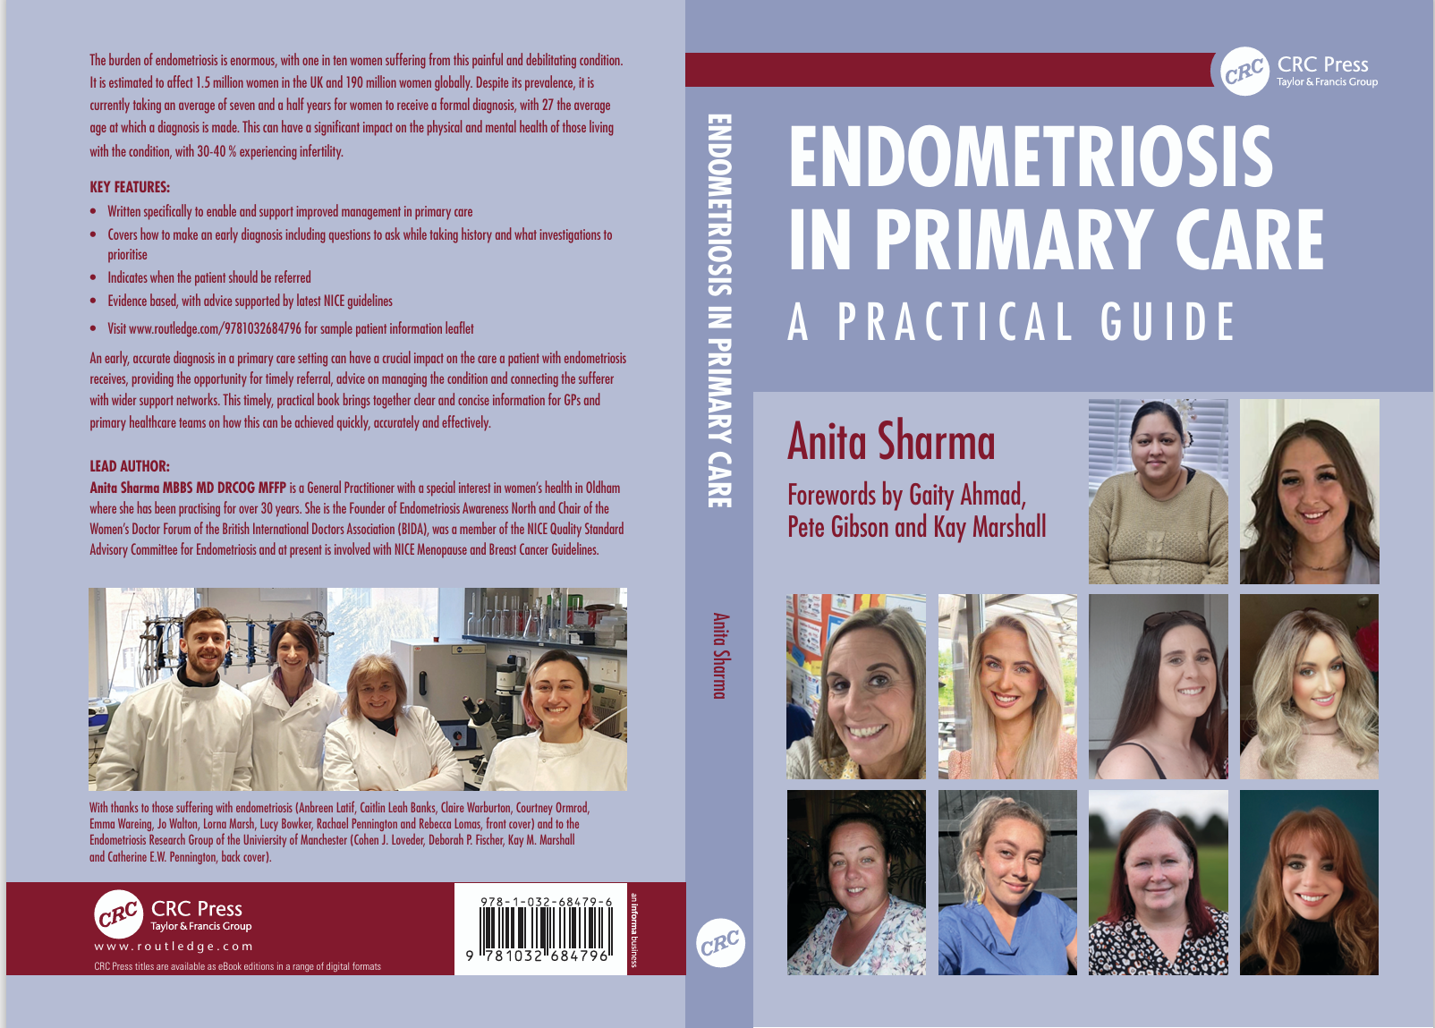

Slide 23


Slide 24

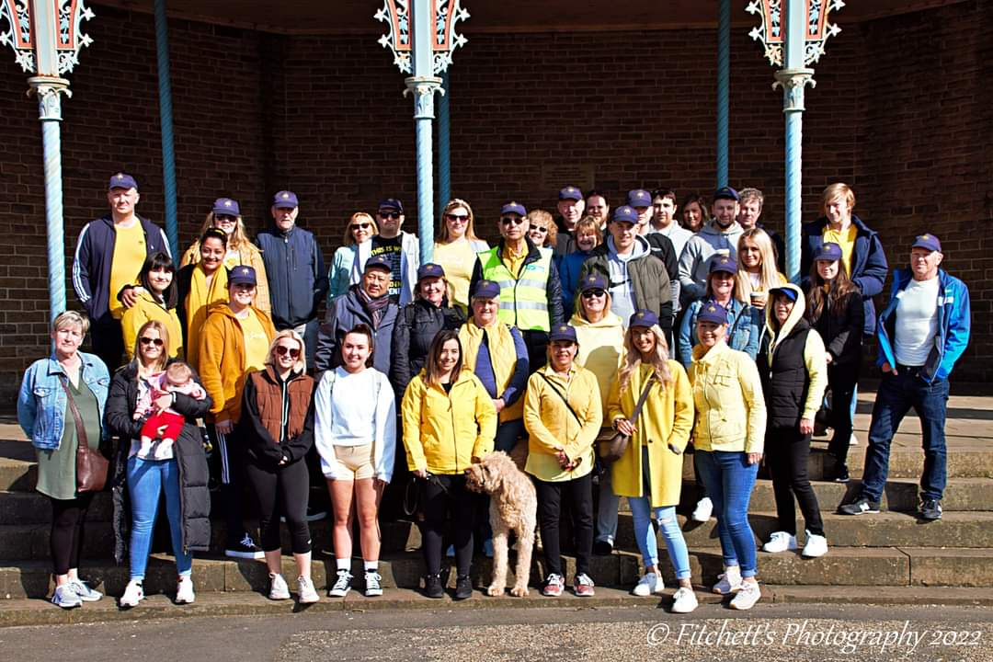
ENDOMETRIOSIS CHARITY 5K WALK 20.3.2022 https://endometriosisawarenessnorth.com/

Slide 25
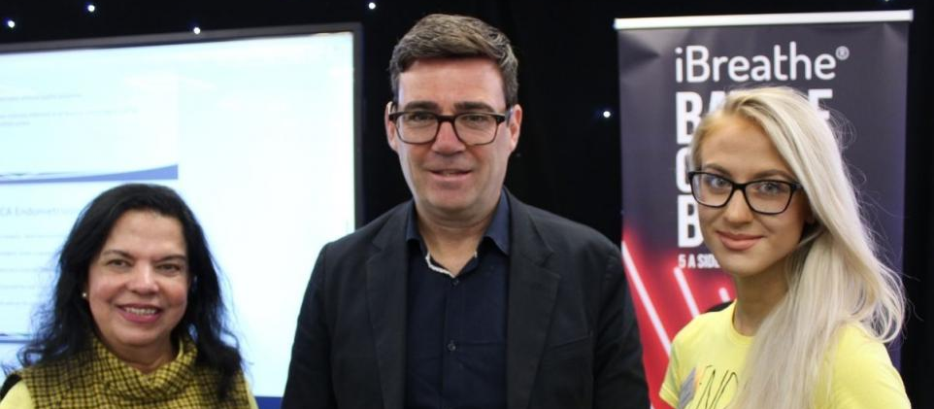
ENDOMETRIOSIS AWARENESS EVENT
1st July 2022

Slide 26
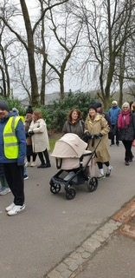

WALK IN QUEEN’S PARK 9.3.2024

Slide 27
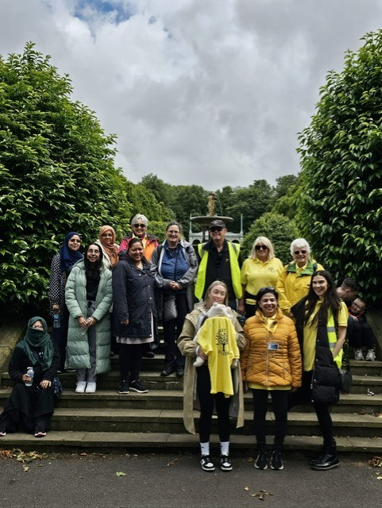
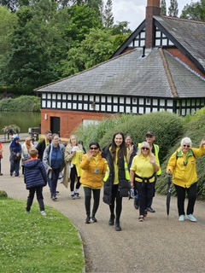
WALK IN OLDHAM TO RAISE AWARENESS 6.7.2024
OLDHAM WALK

Slide 28
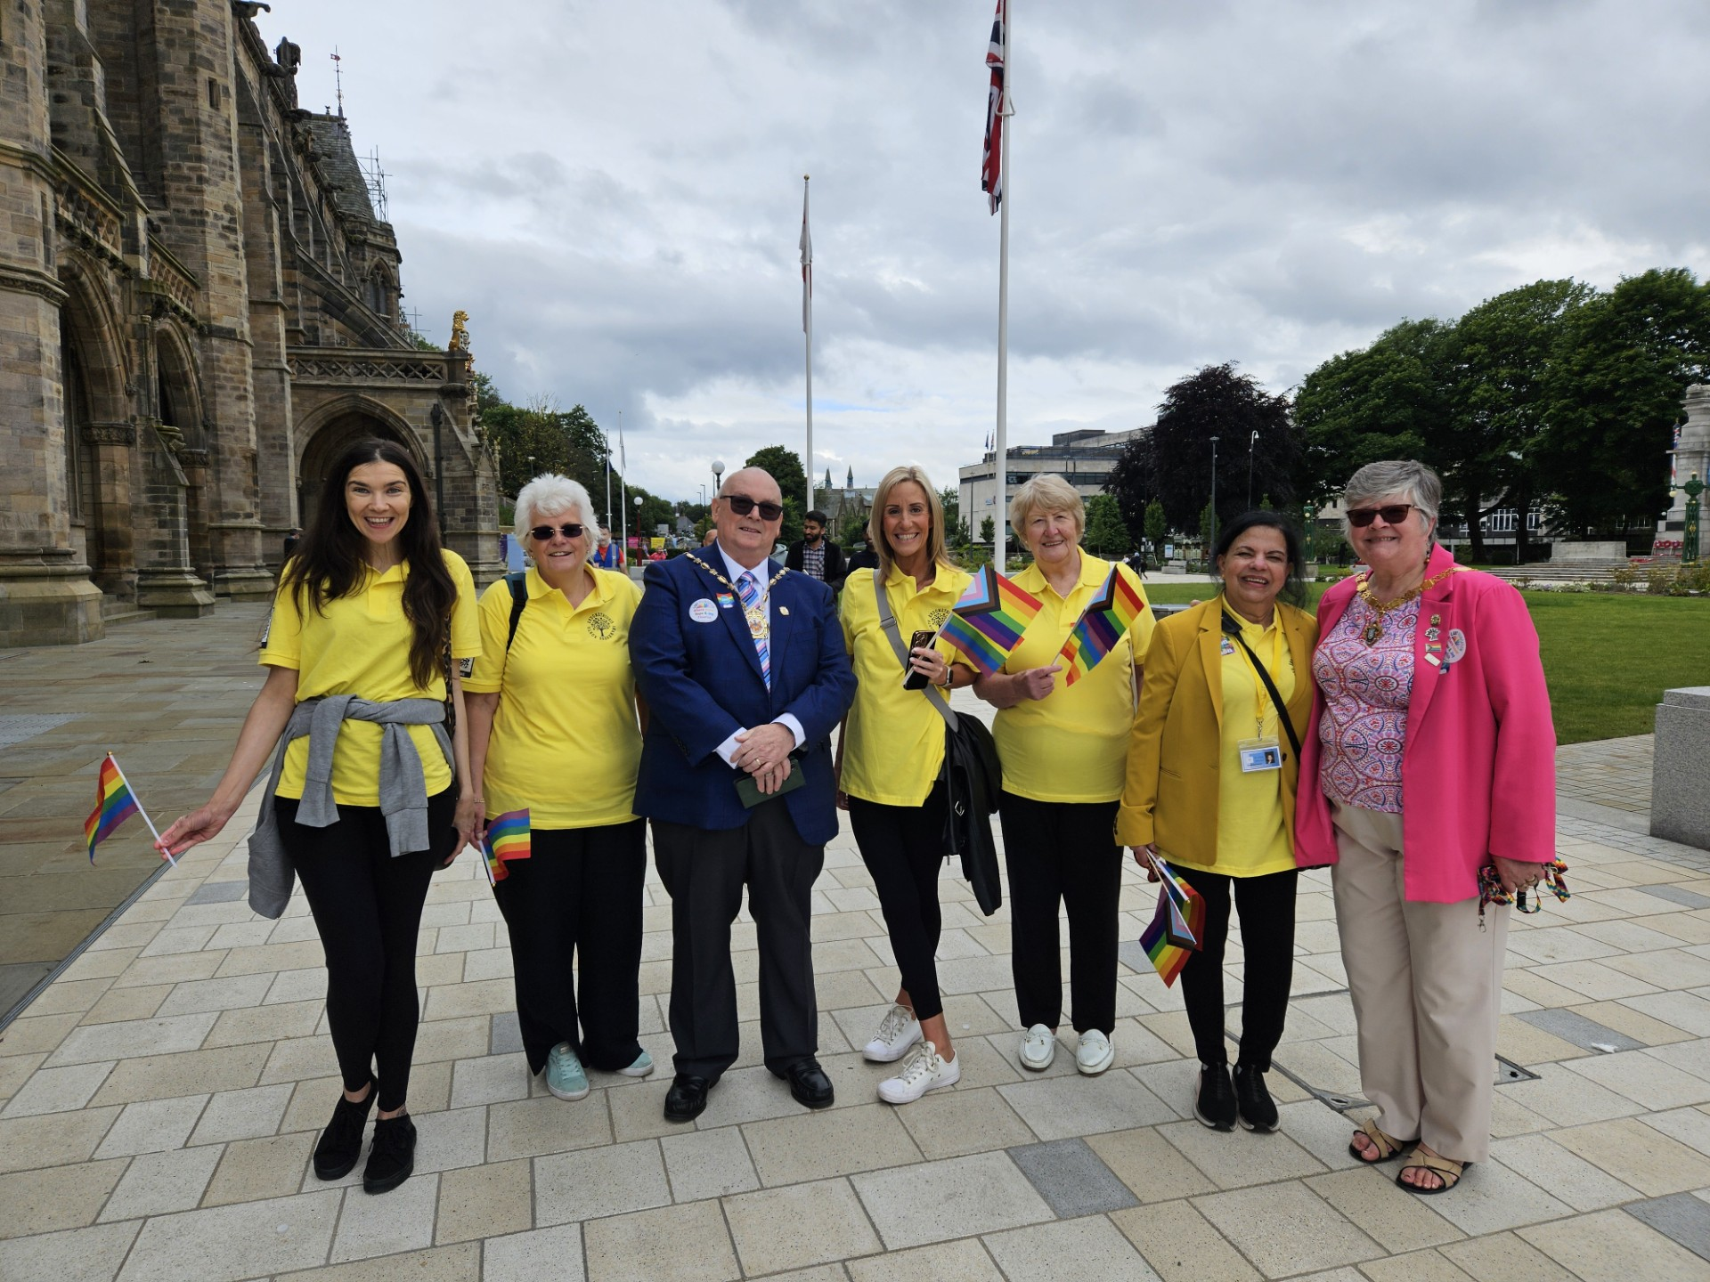
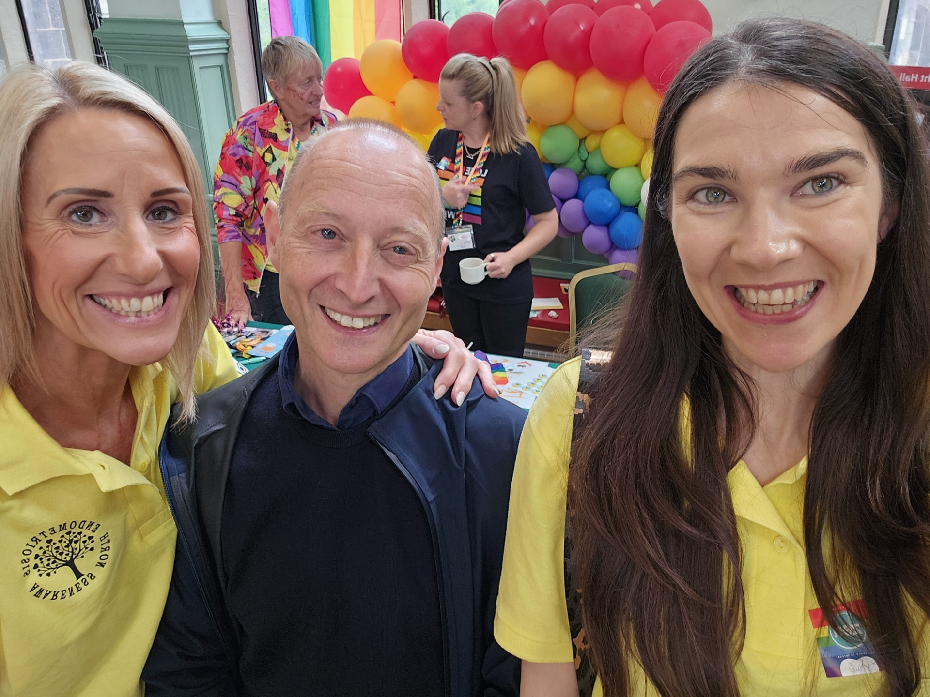
ROCHDALE PRIDE EVENT
13.7.2024

Slide 29
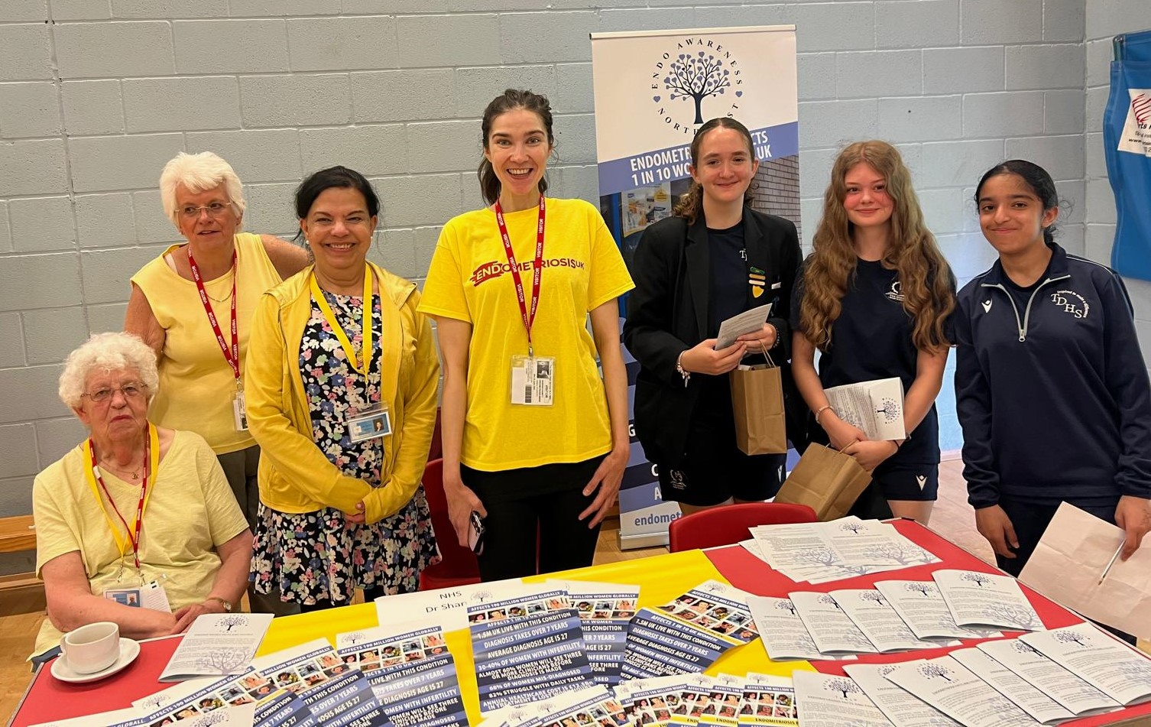
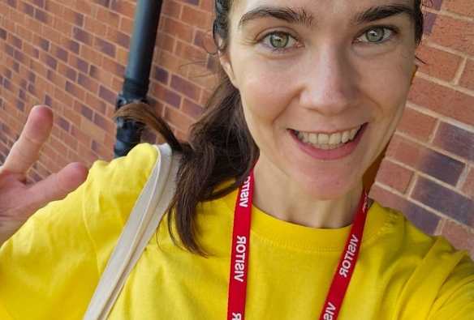
DERBY HIGH SCHOOL 26.3.2024

Slide 30
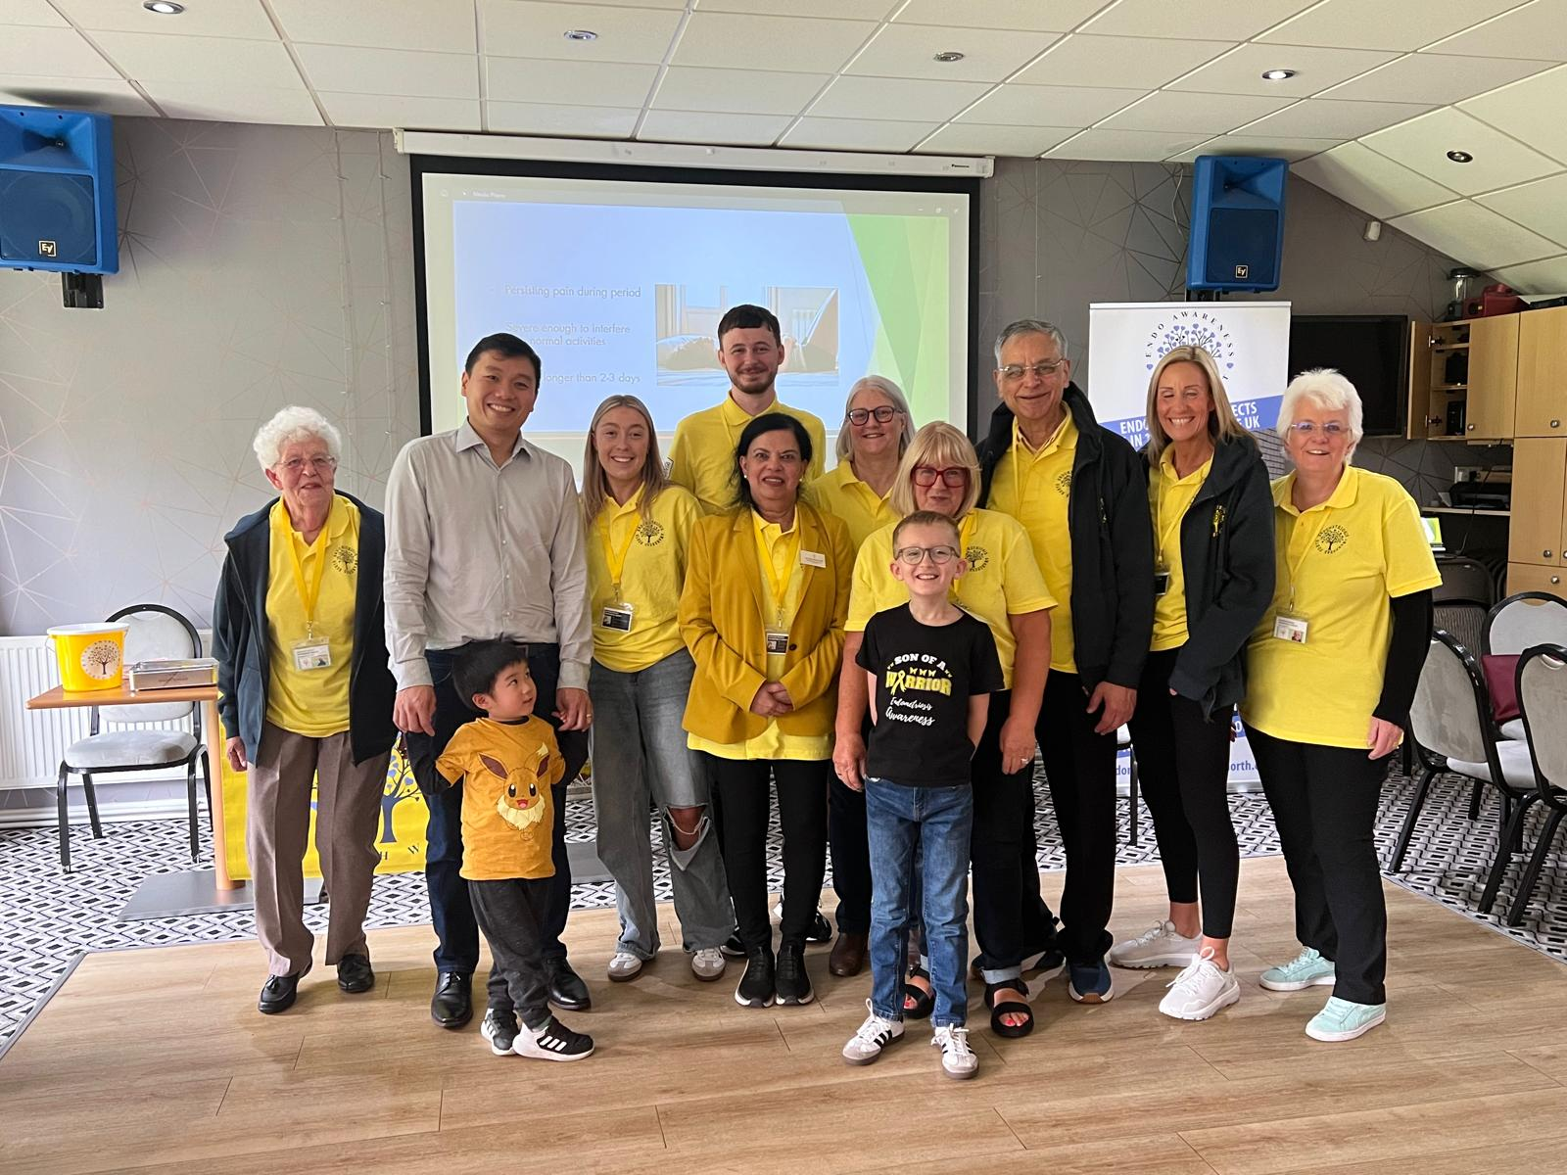
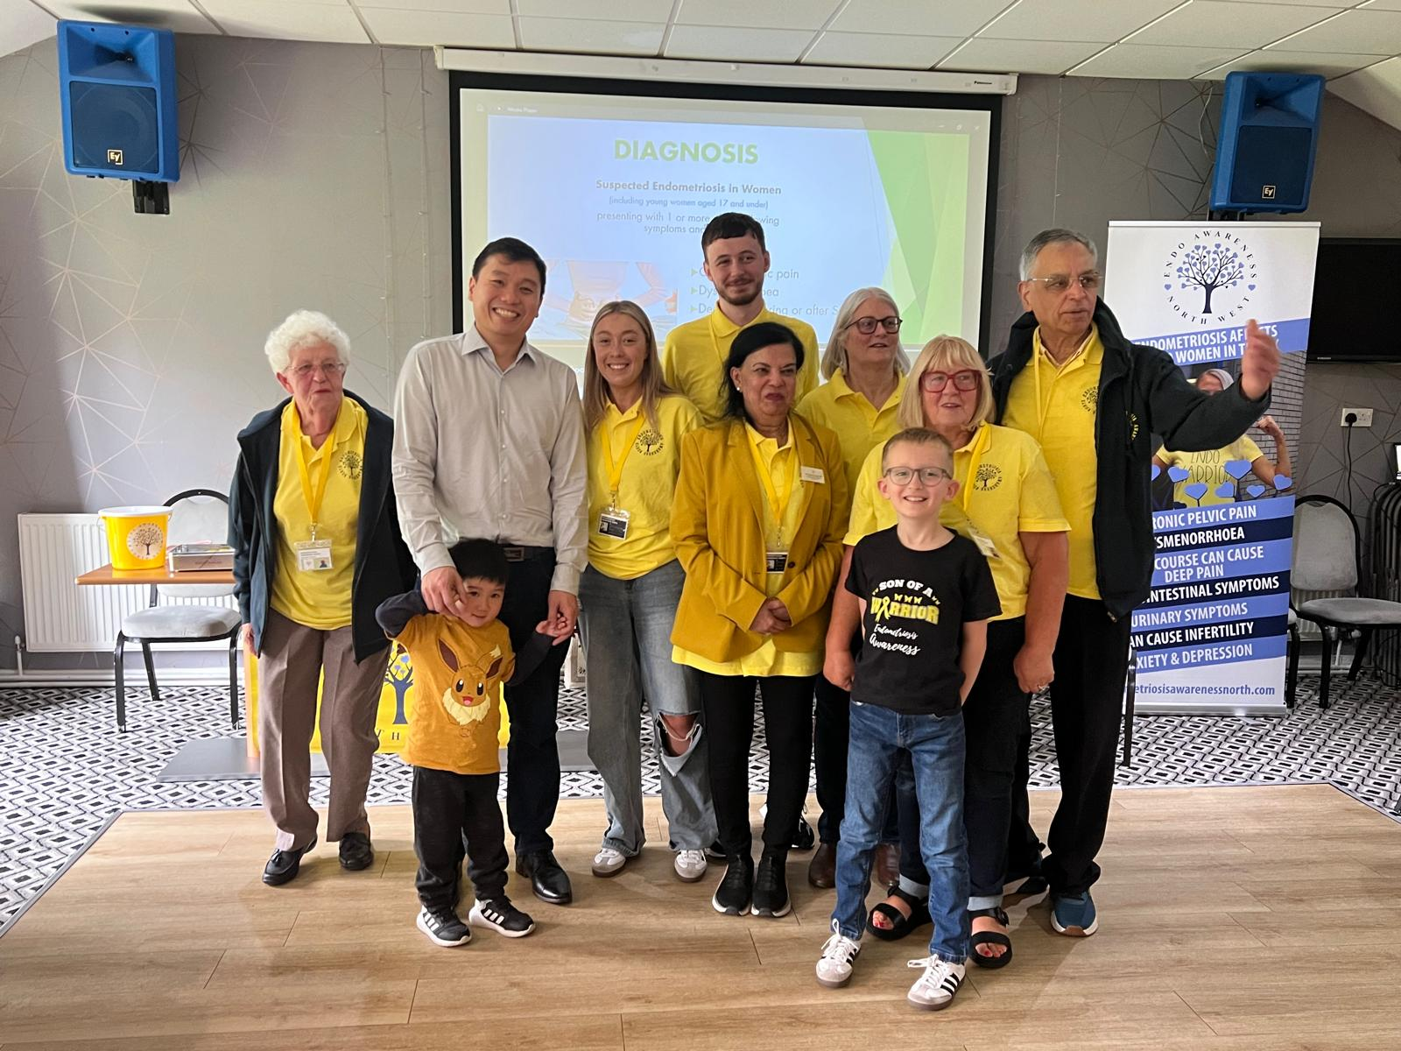
COFFEE MORNING 14.9.2024

Slide 31

WALK HOLLINGWORTH LAKE 22.3.2025

Slide 32
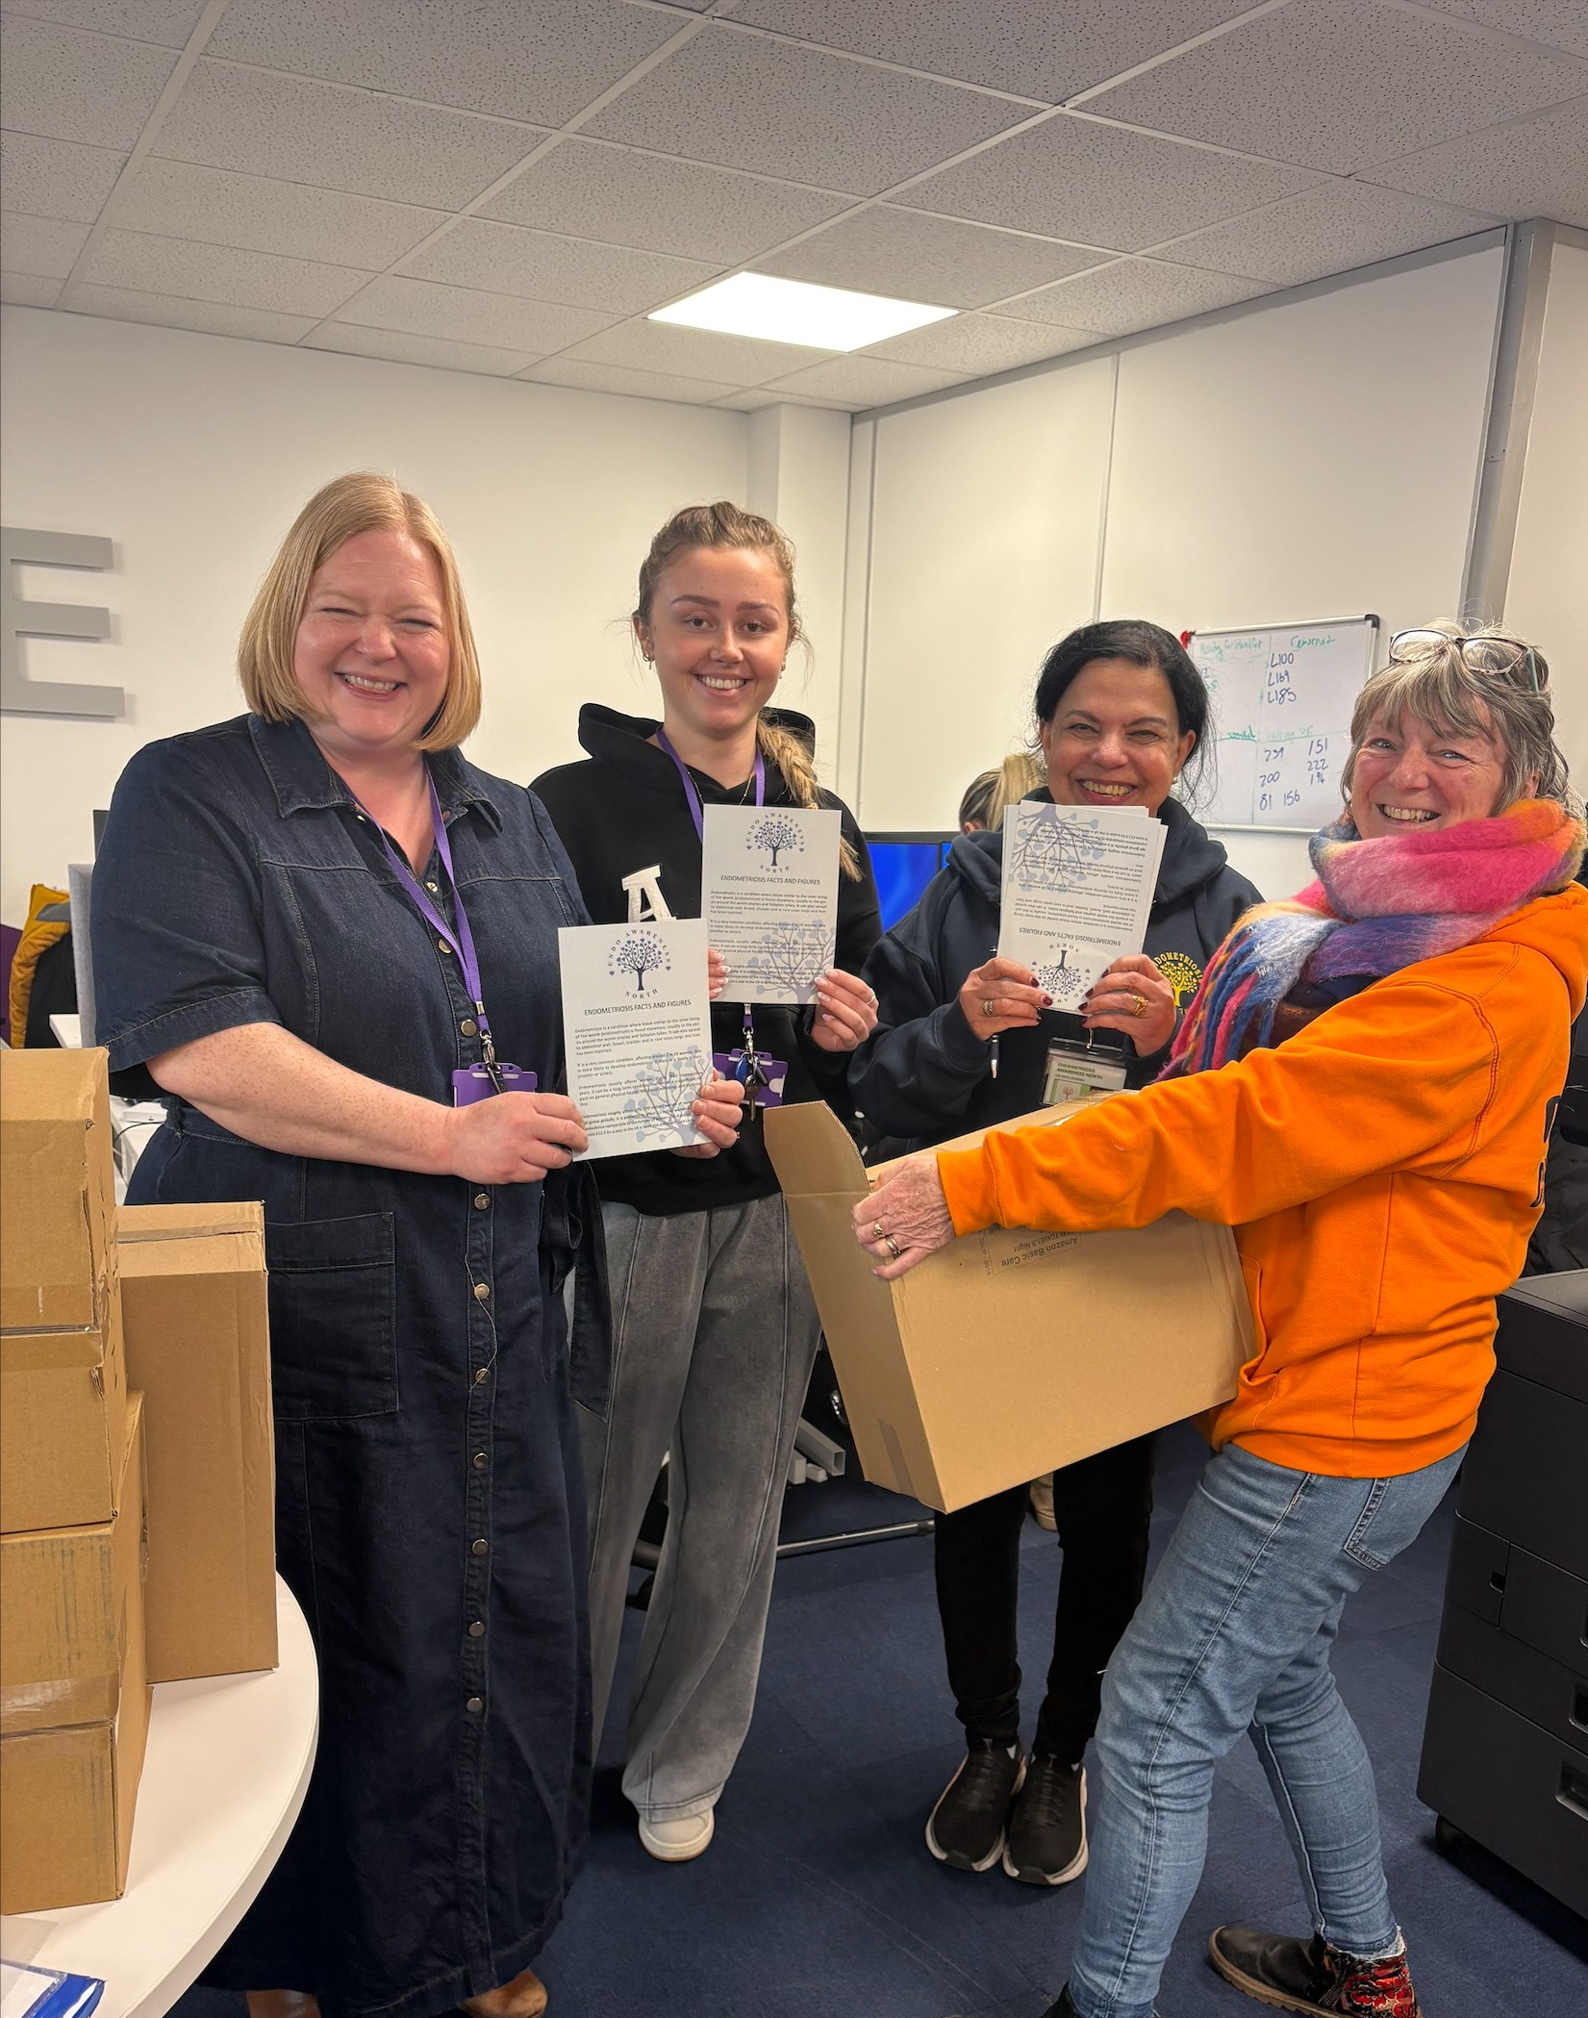
PERIOD POVERTY PROJECT

Slide 33
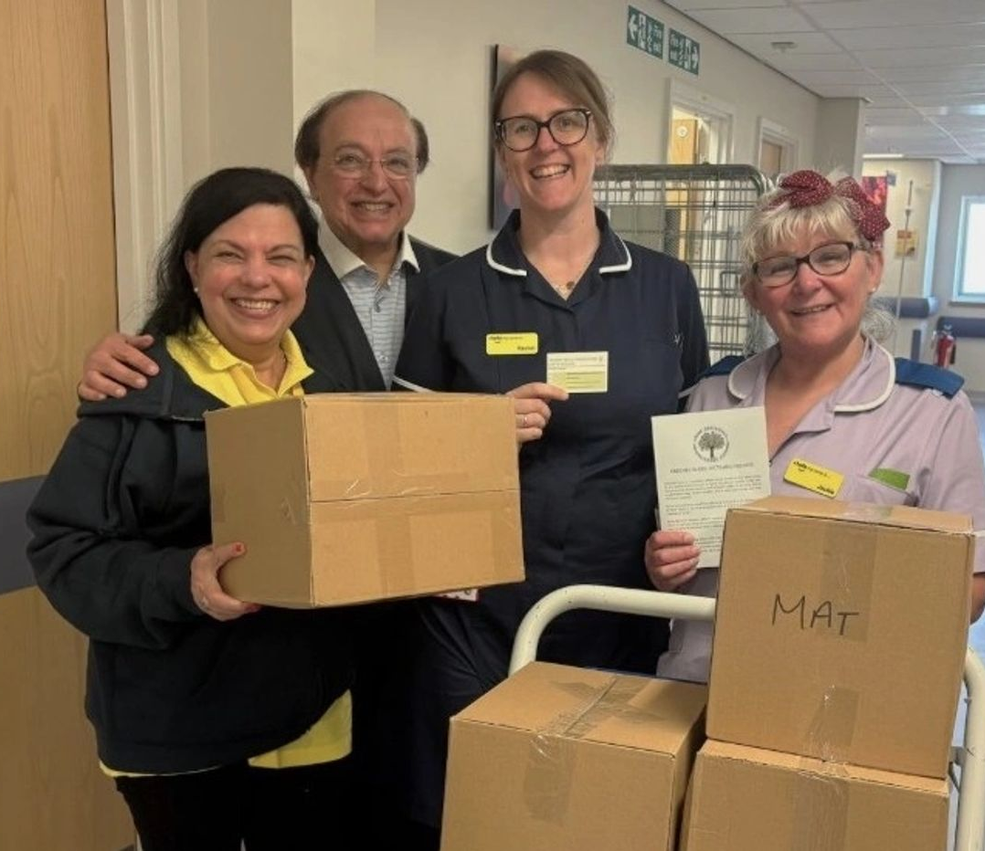
GYNAE CLINIC ROH

Slide 34
Contact the Charity at:
Support the Endometriosis Awareness North by visiting www.endometriosisawarenessnorth.com
This site includes information on the signs and symptoms of endometriosis
Charity Number
We are registered with The Charity Commission. Our Charity number is 1212676.

Slide 35
ENDOMETRIOSIS AWARENESS NORTH TEAM MEMBERS
Dr Anita Sharma
Chair and Founder of Endometriosis Awareness North Charity
Melanie Banks
Secretary and Campaign Ambassador
Lucy Bowker and Courtney Ormrod
Campaign Ambassadors
Kenneth Ma
Consultant Gynaecologist St Mary’s Hospital, specialist in severe endometriosis, advanced laparoscopic surgery, BSGE accredited surgeons in Endometriosis Centre.
Gaity Ahmad
Consultant Gynaecologist and obstetrician ROH specialist in Endometriosis
Andrew Pickersgill
Consultant Gynaecologist and obstetrician Alexandra Hospital specialist in Endometriosis
Margaret Heywood and Susan Richardson
School and College Education about period health
Caroline Yates
Treasurer
Peter Gibson
PR and communications
Janet Kennett
Fundraiser
Dr Ken Ma and Francine Jury
Additional Members

